Slide 1
DATA STRUCTURES
Queue & Circular Queue
FIFO, array implementation, and my wrap-around test
10
20
30
40
50
C++ Programming | Lab 01
Arya Desai
FRONT
REAR
FIFO

Slide 2
01 • IDEA
02
What is a queue?
A queue works like a line of people waiting.
The first person who joins the line is the first person served.
10
20
30
40
FIFO
First In
First Out
FRONT
REAR
My real-life example: a checkout line.
← first out
last in →
C++ Programming • Lab 01
Arya Desai

Slide 3
02 • OPERATIONS
03
The main queue operations
enqueue()
dequeue()
isEmpty()
add an item at the rear
remove an item from the front
check if there are no items
isFull()
displayAll()
front / rear
check if the array is full
show the current queue
track the first and last positions
C++ Programming • Lab 01
Arya Desai

Slide 4
03 • FIFO
04
Enqueue & dequeue
ENQUEUE
DEQUEUE
Add to the rear
Remove from the front
10
20
30
40
10
20
30
→
→
rear
new rear
10 leaves first
First in → first out
C++ Programming • Lab 01
Arya Desai

Slide 5
04 • LINEAR QUEUE
05
Why a basic array queue has a problem
With a linear array, removing items from the front can leave empty spaces behind.
30
40
50
The issue
The front spaces are free, but a simple linear queue may not reuse them without shifting or resetting.
empty
empty
FRONT
REAR
Circular queues solve this by reusing available positions.
C++ Programming • Lab 01
Arya Desai

Slide 6
05 • CIRCULAR
06
How the circular queue reuses space
Instead of stopping at the last array position, the rear wraps back to index 0.
0
1
2
3
4
60
70
30
40
50
Why it helps
The positions freed at the front become available again.
rear moves →
This is the key difference from a basic linear array queue.
4 → 0 → 1
C++ Programming • Lab 01
Arya Desai

Slide 7
06 • WRAP-AROUND
07
My circular wrap-around test
I removed 10 and 20, then added 60 and 70.
BEFORE
AFTER
30
40
50
_
_
→
60
70
50
30
40
60 → index 0
70 → index 1
Rear: index 4 → index 0 → index 1
This is the circular wrap-around required in the lab.
C++ Programming • Lab 01
Arya Desai

Slide 8
07 • IMPLEMENTATION
08
How I built the circular queue
My approach
const int SIZE = 5;
int array[SIZE];
int start;
int end;
int count;
end = (end + 1) % SIZE;
array[end] = value;
count++;
int index = (start + i) % SIZE;
• Static array with 5 positions.
• `start` points to the front.
• `end` points to the rear.
• `count` tracks how many items are stored.
• `% SIZE` makes the indexes wrap around.
The `% SIZE` expression is what allows the index to wrap from 4 back to 0.
C++ Programming • Lab 01
Arya Desai

Slide 9
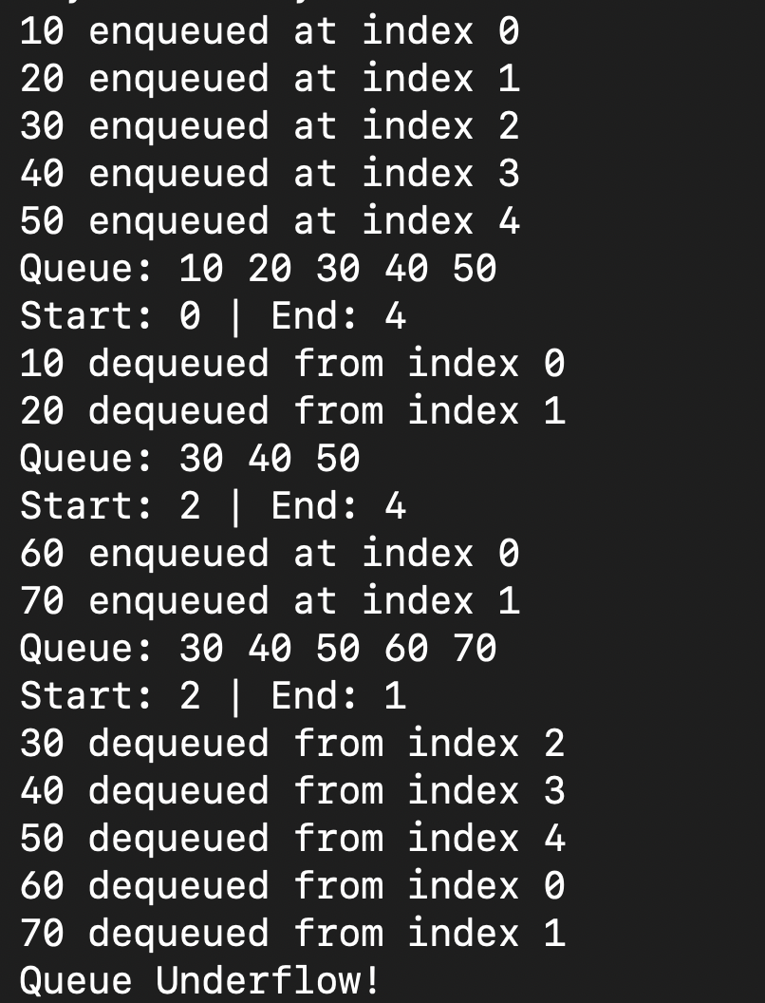
08 • RUN
09
My actual program output
I tested FIFO behavior, reused the freed positions, and checked underflow.
10 & 20 leave first → 60 goes to index 0 → 70 goes to index 1
C++ Programming • Lab 01
Arya Desai

Slide 10
09 • RESULTS
10
What happened in my test?
1
Fill the queue
10, 20, 30, 40, 50 occupy indexes 0–4.
2
Dequeue
10 and 20 are removed from indexes 0 and 1.
3
Wrap
60 goes to index 0 and 70 goes to index 1.
4
Finish
30, 40, 50, 60, 70 leave in FIFO order; then Underflow appears.
C++ Programming • Lab 01
Arya Desai

Slide 11
10 • USES
11
Where queues are useful
Print queues
Scheduling
The first print job waiting is handled first, so jobs are processed in arrival order.
Tasks can wait in order and be handled from the front of the queue.
Customer service
Network packets
Customers are served in the order they arrive.
Packets can wait temporarily and be processed in arrival order.
C++ Programming • Lab 01
Arya Desai

Slide 12
11 • DESIGN CHOICE
12
Advantages & limitations
Advantages
Limitations
• FIFO behavior is simple to understand.
• The array still has a fixed size.
• Circular reuse avoids leaving freed positions unused.
• A full queue can cause overflow.
• Array access and index movement are straightforward.
• The implementation needs careful start/end tracking.
C++ Programming • Lab 01
Arya Desai

Slide 13
12 • REFLECTION
13
What I learned
The circular queue made more sense once I could see the indexes move.
In my test, I first filled the array, removed two items, and then reused those positions for 60 and 70. Seeing the rear move from index 4 back to index 0 helped me understand why the queue is called circular.
FIFO
The oldest item leaves first.
WRAP
The rear can reuse positions at the beginning.
C++
The modulo operator makes the wrap-around possible.
C++ Programming • Lab 01
Arya Desai

Slide 14
13 • SOURCES
14
References
1
Virginia Tech OpenDSA — Stack & Queue
https://opendsa-server.cs.vt.edu/ODSA/Books/CS3S26slides/html/StackQueue.html
2
Virginia Tech OpenDSA — Queue concepts
https://opendsa-server.cs.vt.edu/ODSA/Books/CS3S26slides/html/Queue.html
3
cppreference — C++ Arrays
https://cppreference.com/book/arrays.html
These sources were used for background concepts; the examples, diagrams, code, and testing shown here are my own.
C++ Programming • Lab 01
Arya Desai

